Slide 1





DIABETIC PREDICTION
TRANSFORMING HEALTHCARE
A Journey to Better Lives
Presented by: Group 6

Slide 2


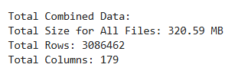
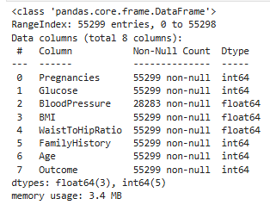
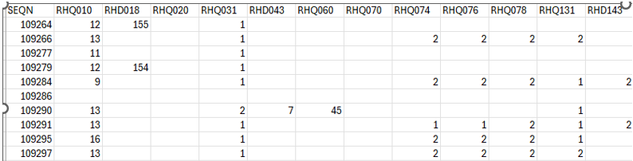
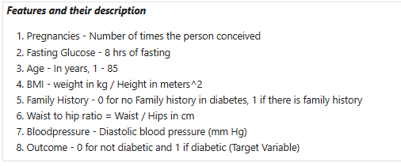
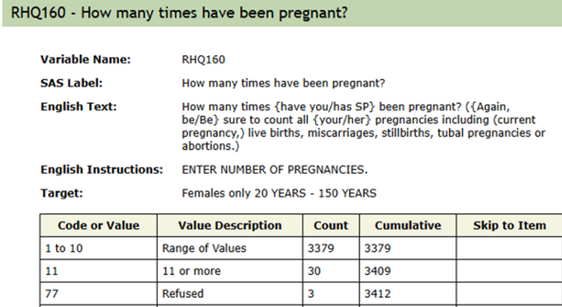
Data Preprocessing and Feature Engineering:
Feature Identification

Slide 3
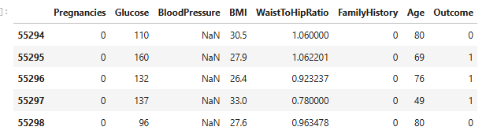
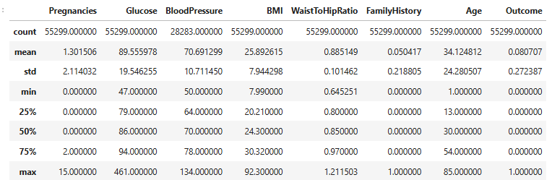
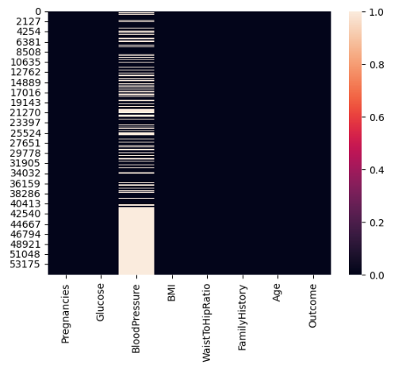
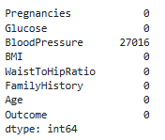
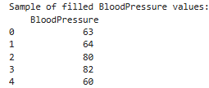

EDA and Feature Engineering:
Blood Pressure has NaN / blank values
We are deciding to keep the BP feature even if it has alot of missing values.
HOW?
We have done Linear Regression instead of filling it up with mean.

Slide 4
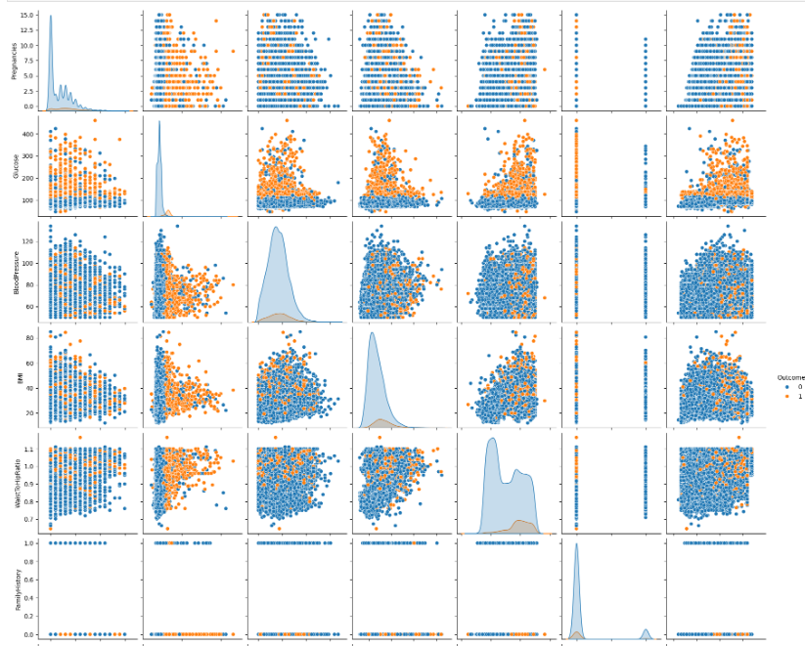
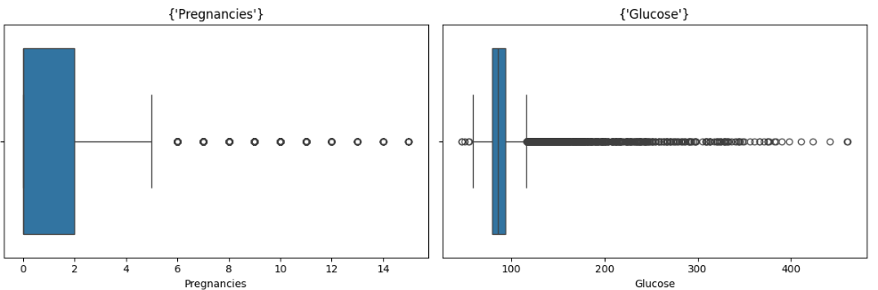
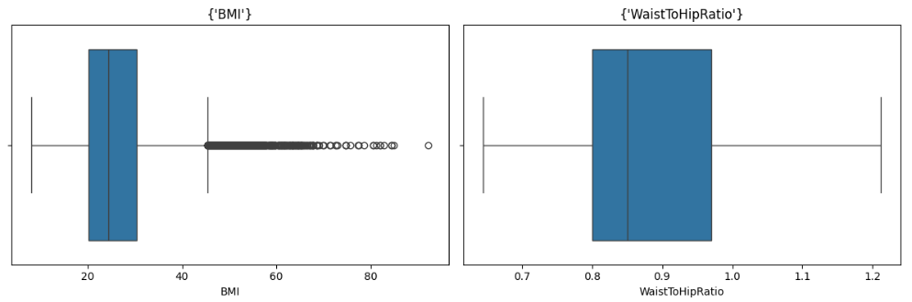
EDA and Feature Engineering:
Observing Outliers
Orange indicators means diabetics, the blue ones are not diabetic
Number of Pregnancies: Majority 0-2, some up to 15
Glucose: Majority around 100, some up to 400+
BMI and Waist to Hip Ratio, outliers may indicate Obesity
Deduplication not done because these are unique individual’s features, and had corresponding ID#s from the questionnaires
We are keeping outliers because they have meaningful information, important in predicting diabetes

Slide 5
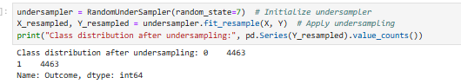
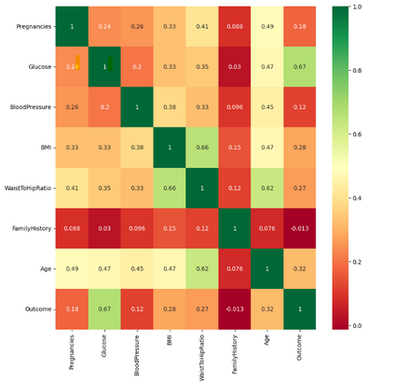
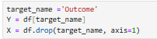

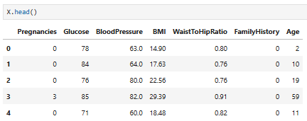
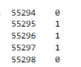
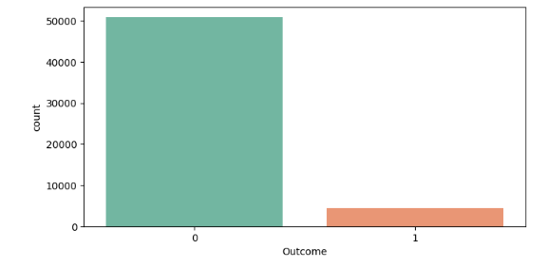
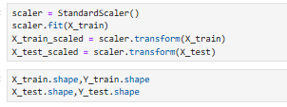
EDA and Feature Engineering:
Correlation Matrix to the Target Variable (Outcome)
We have balanced the dataset resulting to 4463 records each for diabetic and not diabetic
Identifying the Axis
BMI &Waist to Hip Strong, correlation
Glucose, Age, BMI and Waist to hip correlated to Outcome
Y as the Outcome and X are the other features
Avoiding Data Leakage
Target Variable showing unbalanced dataset
We have scaled the data after splitting

Slide 6
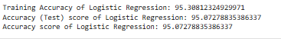
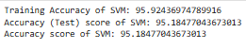
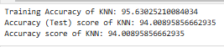
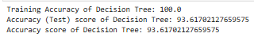


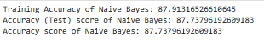
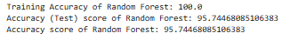
Model Building and Evaluation
We have used 6 different Machine learning models to predict overfitting, underfitting and Accuracy

Slide 7
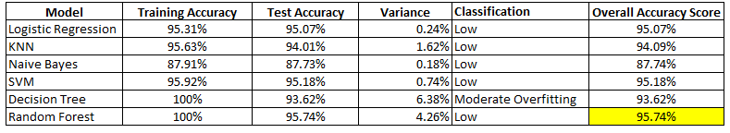

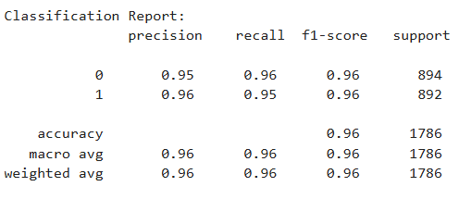
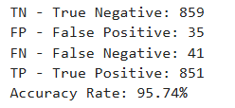
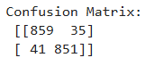
Model Building and Evaluation
Model comparison board
Classification Report

Slide 8
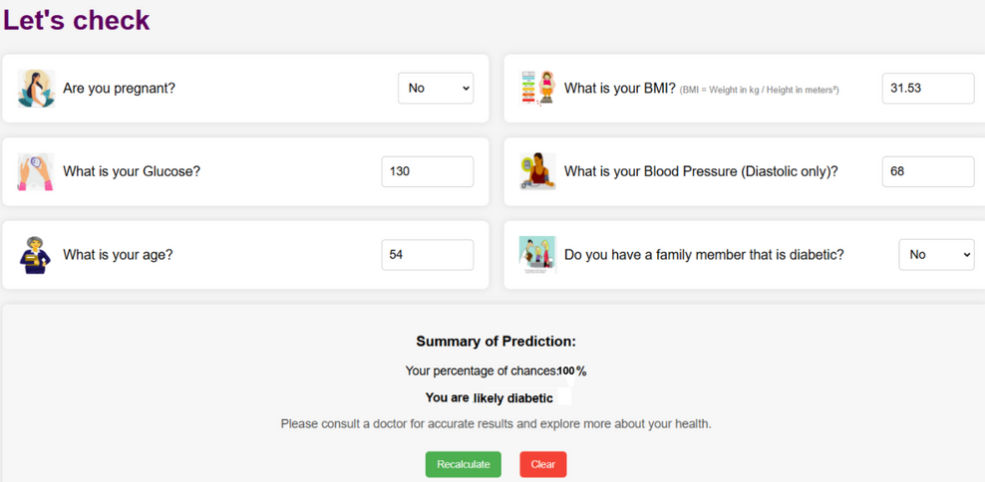



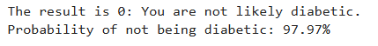
Is It the Model Predicting Appropriately?
Random Forest Results
SVM Results

Slide 9

Valuable Insights
Glucose Levels as Primary Predictor
Insight: High glucose levels correlate strongly with diabetes risk.
Technique: Correlation analysis and clustering.
Use: Regular glucose screening for early risk identification.
Impact: Reduces complications, improves outcomes, lowers costs.
BMI & Waist-to-Hip Ratio as Indicators
Insight: Higher BMI and waist-to-hip ratios link to diabetes.
Technique: Regression and association studies.
Use: Routine screenings for BMI and waist-to-hip; targeted interventions.
Impact: Reduces diabetes prevalence, healthcare costs, and delays onset.
Age as Secondary Risk Factor
Insight: Diabetes incidence increases with age, especially 40+.
Technique: Age-related analysis and stratification.
Use: Age-based risk assessments and tailored screenings.
Impact: Efficient resource allocation, reduces undiagnosed cases, lowers costs.
DOCTOR’S INSIGHTS ON OUR PROJECT

